Slide 1



Angus
Lee
RISK-OPTIMIZED PORTFOLIO PROJECT
Applying modern portfolio theory
linkedin.com/in/angusleebusiness
angusleebusiness@gmail.com

Slide 2

Project Overview
Angus
Lee
Modern Portfolio Theory (MPT)
A method to construct diversified portfolios for risk averse investors.
Maximizes profits without exposing the investor to intolerable amounts of variance represented by the Sharpe ratio.
Inspired Post-Modern Portfolio Theory (PMPT) and the Sortino ratio.
The Sortino ratio compares the amount of expected profit per unit of financial risk.

Slide 3

Angus
Lee
Project Overview
This project involved hand selecting a group of stocks that covered the four areas of financial instruments: USA equities, international equities, commodities, and fixed-income. Further areas such as big-tech, small market-cap companies, risky stocks, etc were labelled. After setting range constraints on each identified area, an evolutionary algorithm(Differential Evolution) was used to optimize the financial risk-adjusted return.
Data Mining & Manipulation
I leveraged Alpaca API and Python to call the historical data of each financial instrument selected. The data was stored in a Pandas DataFrame and manipulated before being exported into a csv file for financial analysis.

Slide 4

Angus
Lee
Optimization Process
Prologue
Covariance Matrix
Calculations
Optimization
Identify the categories that each instrument falls into such as Alibaba into big-tech and international, or NASDAQ:VGLT into USA and fixed-income. Identify acceptable max and min weights for each category.
Using Excel’s data analysis ToolPak, I calculated the covariance matrix of the daily negative returns of each instrument, setting all positive returns to zero for this calculation
Use spreadsheet functions and equations to calculate total portfolio standard deviation, expected returns, Sortino ratio, and instrument category weights.
Run the evolutionary algorithm with the conditions decided to optimize the Sortino ratio: instrument category weight constraints, 100k max iterations, 10k stagnation limit, a stagnation tolerance of 0.000001, and with each instrument weight initially set to 0%.

Slide 5
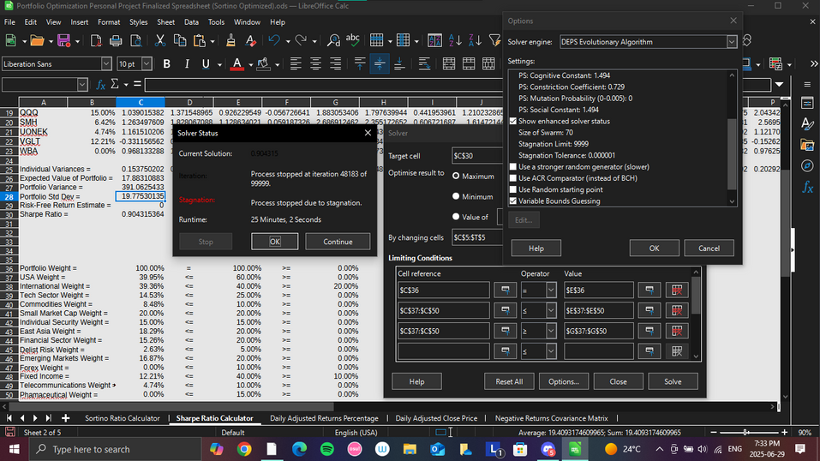
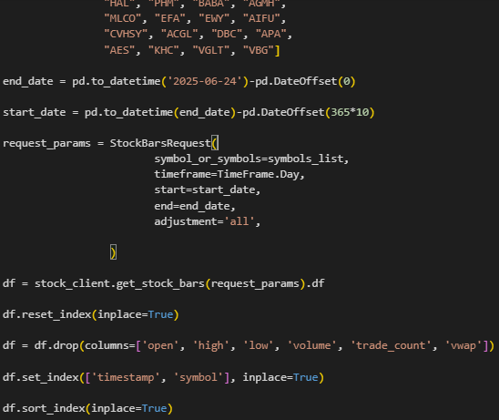
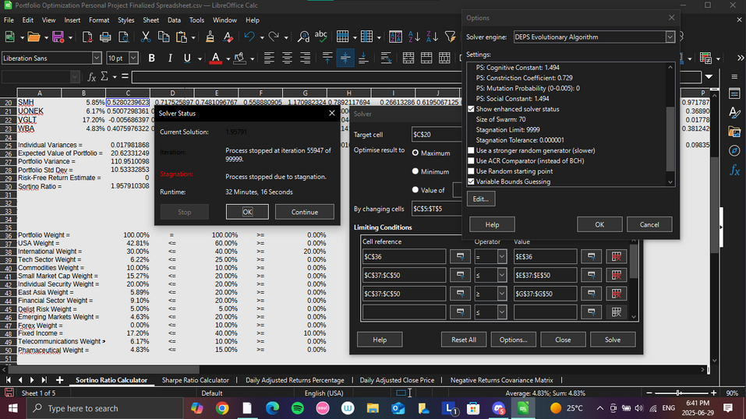
Angus
Lee
Photos of the Process

Slide 6
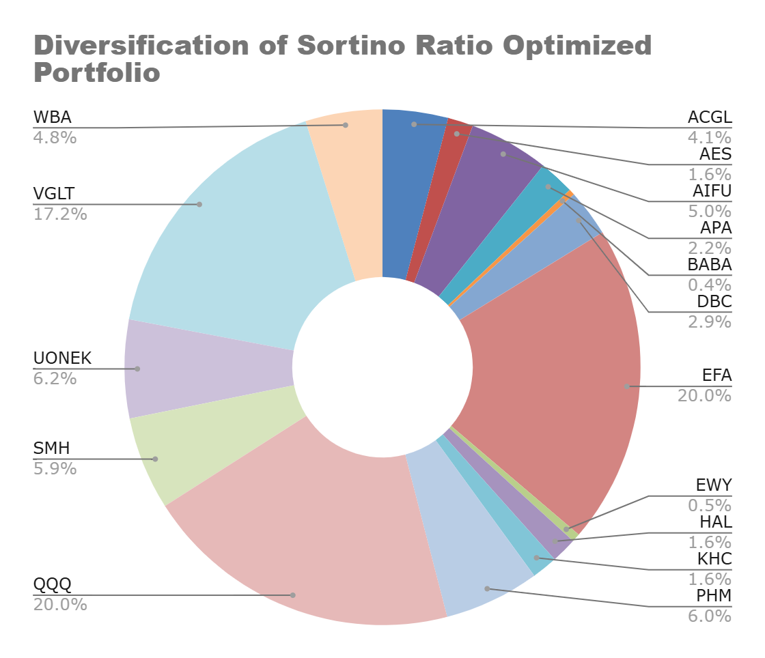
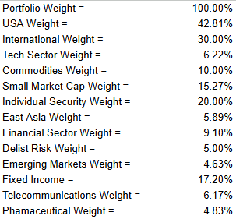
Angus
Lee
Optimization Outcome
After running the solver for almost 56k iterations for more than half an hour, the Sortino ratio reached 1.96 with an annualized expected return of 20.6% while fulfilling all the category weight constraints.

Slide 7
Angus
Lee
Optimization Outcome

Slide 8
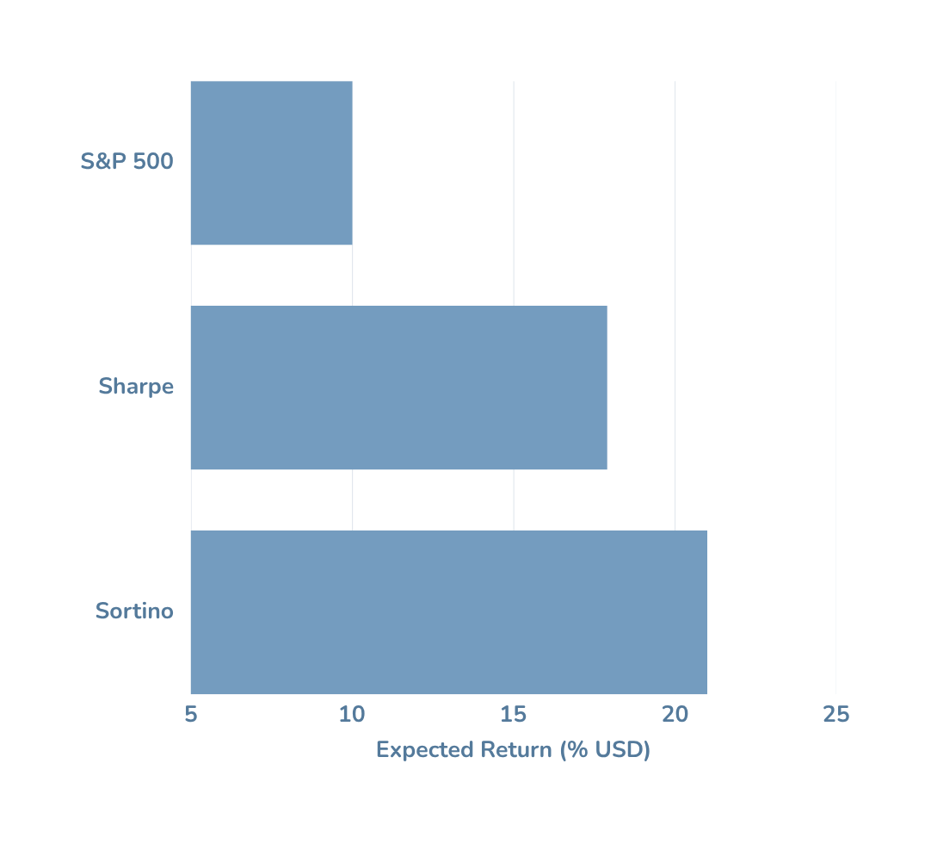
Angus
Lee
Outcome Comparison
Both the risk-optimized portfolios(Sharpe & Sortino) have higher expected return than the S&P 500.
All three profiles offers broad US market exposure.
The S&P 500 is market weighted and favours high market capitalization stocks, introducing more unsystematic risk.

Slide 9

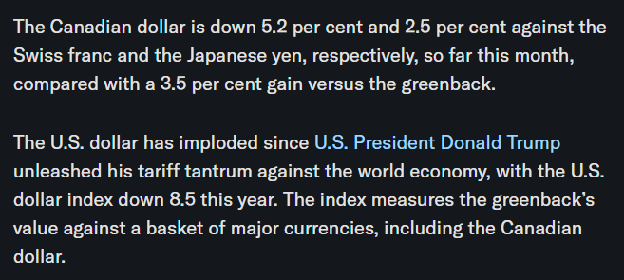
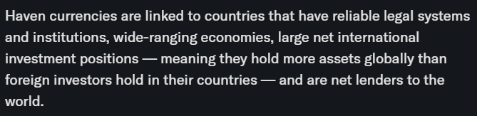
Angus
Lee
Final Notes
In light of recent currency instability, in future models, it would be wise to invest in foreign currency such as the Swiss Franc or Japanese Yen.
The plan was to originally include Vanguard Global ex-U.S. Aggregate Bond Index ETF (TO:VBG) and the Swiss Franc as part of the Sortino ratio optimization.
Alpaca API could not provide the data.
These two could be included as a separate portfolio with a arbitrarily determined allocation of funds and optimized independently from the others.
linkedin.com/in/angusleebusiness
angusleebusiness@gmail.com

Slide 10

Angus
Lee
Thank You So Much
Website :
linkedin.com/in/angusleebusiness
Social Media :
Mail Address :
@angoose_lee
angusleebusiness@gmail.com

